Slide 1


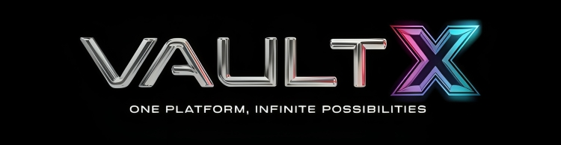
The Problem: Secure Cloud Data Management
B K BIRLA HACKATHON
Vault-X
One Platform, Infinite Possibilities
THEME: ARTIFICIAL INTELLIGENCE IN SECURITY
TEAM NAME: TEAM CYBER
With vast amount of sensitive data stored in the cloud, organizations struggle to maintain privacy while meeting regulatory requirements. The challenge is to integrate encryption,role-based access control, and real-time threat detection to protect confidential information without affecting cloud efficiency and scalability

Slide 2

Vault-X Solution: One Platform, Multiple Benefits
B K BIRLA HACKATHON
The Problem: Secure Cloud Data Management
With vast amount of sensitive data stored in the cloud, organizations struggle to maintain privacy while meeting regulatory requirements. The challenge is to integrate encryption,role-based access control, and real-time threat detection to protect confidential information without affecting cloud efficiency and scalability
THEME: ARTIFICIAL INTELLIGENCE IN SECURITY
TEAM NAME: TEAM CYBER
Saas Service For Organizations
2
Integrate Encryption
Our platform employs advanced encryption algorithms to safeguard data at rest and in transit.
3
Vault-X is a user-friendly SaaS platform that provides a comprehensive solution for securing sensitive data.
4
Role-Based Access Control
Real-Time Threat Detection
We implement granular access controls, ensuring that only authorized users can access specific data.
Vault-X uses AI-powered threat detection to identify and mitigate potential vulnerabilities in real-time.

Slide 3
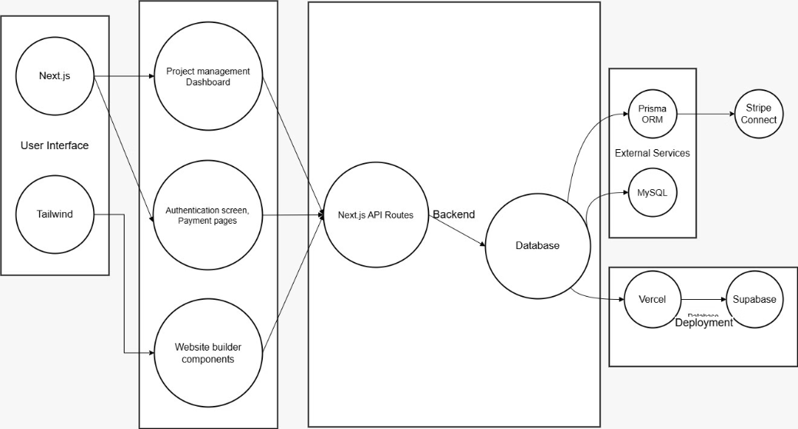
Vault-X Architecture: A Robust Foundation
The Problem: Secure Cloud Data Management
Vault-X Solution: One Platform, Multiple Benefits
1
Saas Service For Organizations
2
Integrate Encryption
Our platform employs advanced encryption algorithms to safeguard data at rest and in transit.
Vault-X is a user-friendly SaaS platform that provides a comprehensive solution for securing sensitive data.
3
Role-Based Access Control
4
Real-Time Threat Detection
We implement granular access controls, ensuring that only authorized users can access specific data.
Vault-X uses AI-powered threat detection to identify and mitigate potential vulnerabilities in real-time.
With vast amount of sensitive data stored in the cloud, organizations struggle to maintain privacy while meeting regulatory requirements. The challenge is to integrate encryption,role-based access control, and real-time threat detection to protect confidential information without affecting cloud efficiency and scalability
User Interaction Layer
API Layer
Authentication & Authorization
Payment Processing
Next.js
Next.js API routes
Stripe
Tailwind
Clerk

Slide 4
Vault-X Solution: One Platform, Multiple Benefits
Feasibility & Viability: A Comprehensive Analysis
Vault-X Architecture: A Robust Foundation
Scalability Risks
We are prepared to address scalability challenges through optimized APIs, caching, and database management.
High Market Potential
The demand for a secure and user-friendly data management platform is significant.
Competition Challenge
We differentiate Vault-X through an intuitive UI and unique features.
Security & Compliance
We prioritize security by implementing robust authentication and secure payment processing.
Cost Control
We optimize hosting and database queries to ensure cost-effectiveness.
Real-Time Updates
We utilize WebSockets and Prisma to ensure smooth collaboration and real-time updates.
User Interaction Layer
API Layer
Authentication & Authorization
Payment Processing
Next.js
Next.js API routes
Stripe
Tailwind
Clerk
1
Saas Service For Organizations
2
Integrate Encryption
3
Our platform employs advanced encryption algorithms to safeguard data at rest and in transit.
Vault-X is a user-friendly SaaS platform that provides a comprehensive solution for securing sensitive data.
Role-Based Access Control
Real-Time Threat Detection
We implement granular access controls, ensuring that only authorized users can access specific data.
Vault-X uses AI-powered threat detection to identify and mitigate potential vulnerabilities in real-time.
4

Slide 5






Vault-X Architecture: A Robust Foundation
Feasibility & Viability: A Comprehensive Analysis
High Market Potential
Scalability Risks
Empowers Businesses
Affordable
Secure & Private
Real-Time Security
The demand for a secure and user-friendly data management platform is significant.
We are prepared to address scalability challenges through optimized APIs, caching, and database management.
Vault-X provides a secure and user-friendly platform for businesses of all sizes.
Vault-X reduces web development costs, making secure data management accessible to all.
Our platform prioritizes data security with encryption and role-based access control.
Vault-X uses AI-powered threat detection to ensure proactive security measures.
Security & Compliance
Competition Challenge
We prioritize security by implementing robust authentication and secure payment processing.
We differentiate Vault-X through an intuitive UI and unique features.
Real-Time Updates
Cost Control
Eco-Friendly
Improves Collaboration
We utilize WebSockets and Prisma to ensure smooth collaboration and real-time updates.
We optimize hosting and database queries to ensure cost-effectiveness.
Vault-X promotes sustainability by reducing paper use and promoting digital workflows.
Our platform enhances teamwork with real-time tools and seamless communication.
User Interaction Layer
API Layer
Authentication & Authorization
Payment Processing
Next.js
Next.js API routes
Stripe
Tailwind
Clerk

Slide 6
Feasibility & Viability: A Comprehensive Analysis
Impact & Benefits: Empowering Businesses with Confidence
Scalability Risks
We are prepared to address scalability challenges through optimized APIs, caching, and database management.
High Market Potential
The demand for a secure and user-friendly data management platform is significant.
Empowers Businesses
Affordable
Secure & Private
Real-Time Security
Vault-X provides a secure and user-friendly platform for businesses of all sizes.
Vault-X reduces web development costs, making secure data management accessible to all.
Our platform prioritizes data security with encryption and role-based access control.
Vault-X uses AI-powered threat detection to ensure proactive security measures.
Competition Challenge
We differentiate Vault-X through an intuitive UI and unique features.
Security & Compliance
We prioritize security by implementing robust authentication and secure payment processing.
Cost Control
We optimize hosting and database queries to ensure cost-effectiveness.
Real-Time Updates
Eco-Friendly
Improves Collaboration
We utilize WebSockets and Prisma to ensure smooth collaboration and real-time updates.
Vault-X promotes sustainability by reducing paper use and promoting digital workflows.
Our platform enhances teamwork with real-time tools and seamless communication.

Slide 7

Research & References: A Foundation for Innovation
Empowers Businesses
Affordable
Secure & Private
Real-Time Security
Vault-X provides a secure and user-friendly platform for businesses of all sizes.
Vault-X reduces web development costs, making secure data management accessible to all.
Our platform prioritizes data security with encryption and role-based access control.
Vault-X uses AI-powered threat detection to ensure proactive security measures.
Shadcn - https://ui.shadcn.com/
Next.js - https://nextjs.org/
Prisma - https://www.prisma.io/
Stripe – https://stripe.com/in
TypeScript- https://www.typescriptlang.org/
Eco-Friendly
Improves Collaboration
Vault-X promotes sustainability by reducing paper use and promoting digital workflows.
Our platform enhances teamwork with real-time tools and seamless communication.

Slide 8
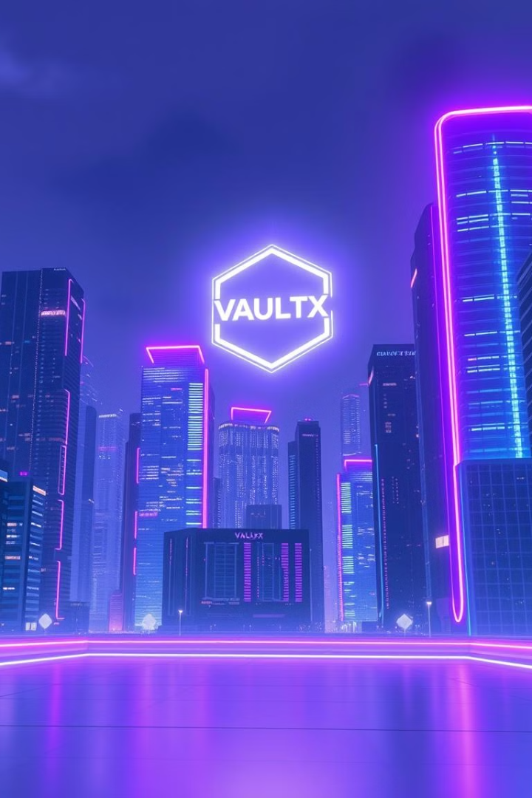
Thank You
Vault-X, The Future of Secure Data Management

